Slide 1

Medvoice sign up & login design
Gevork Asatryan
12/22/2015

Slide 2
Terms and acronyms
Terms and Acronyms | Definitions
Careclient | All ordinary users (patients) who will be seeking help from Caregivers.
Caregiver | Caregivers will be the doctors, nurses and practitioners who will be offering their help to the Careclients.
HTML | HyperText Markup Language is the standard markup language used to create web pages.
JS | JavaScript is the programming language of HTML and the Web.
MySQL | An open-source relational database management system (RDBMS).
MongoDB | A cross-platform document-oriented database. Classified as a NoSQL (Non-Structure Query Language) database.
SQL | Structured Query Language is a special-purpose programming language designed for managing data held in a relational database management system (RDBMS).

Slide 3

Overall description
Purpose
This design document describes the architecture of how users register and login to their MedVoice accounts.
Scope
To have a fully functioning sign up and login activity that will collect user information and store it into the MongoDB database to be used for correlation later. Along with the username and password, there will be a personal profile for each user. During registration, users will be prompted to do a digital signature agreeing to terms and conditions TBD. Facebook login will also be integrated so we can retrieve more information from users that may be used during data correlation between similar age groups, similar interests, nearby geographic locations, etc…

Slide 4
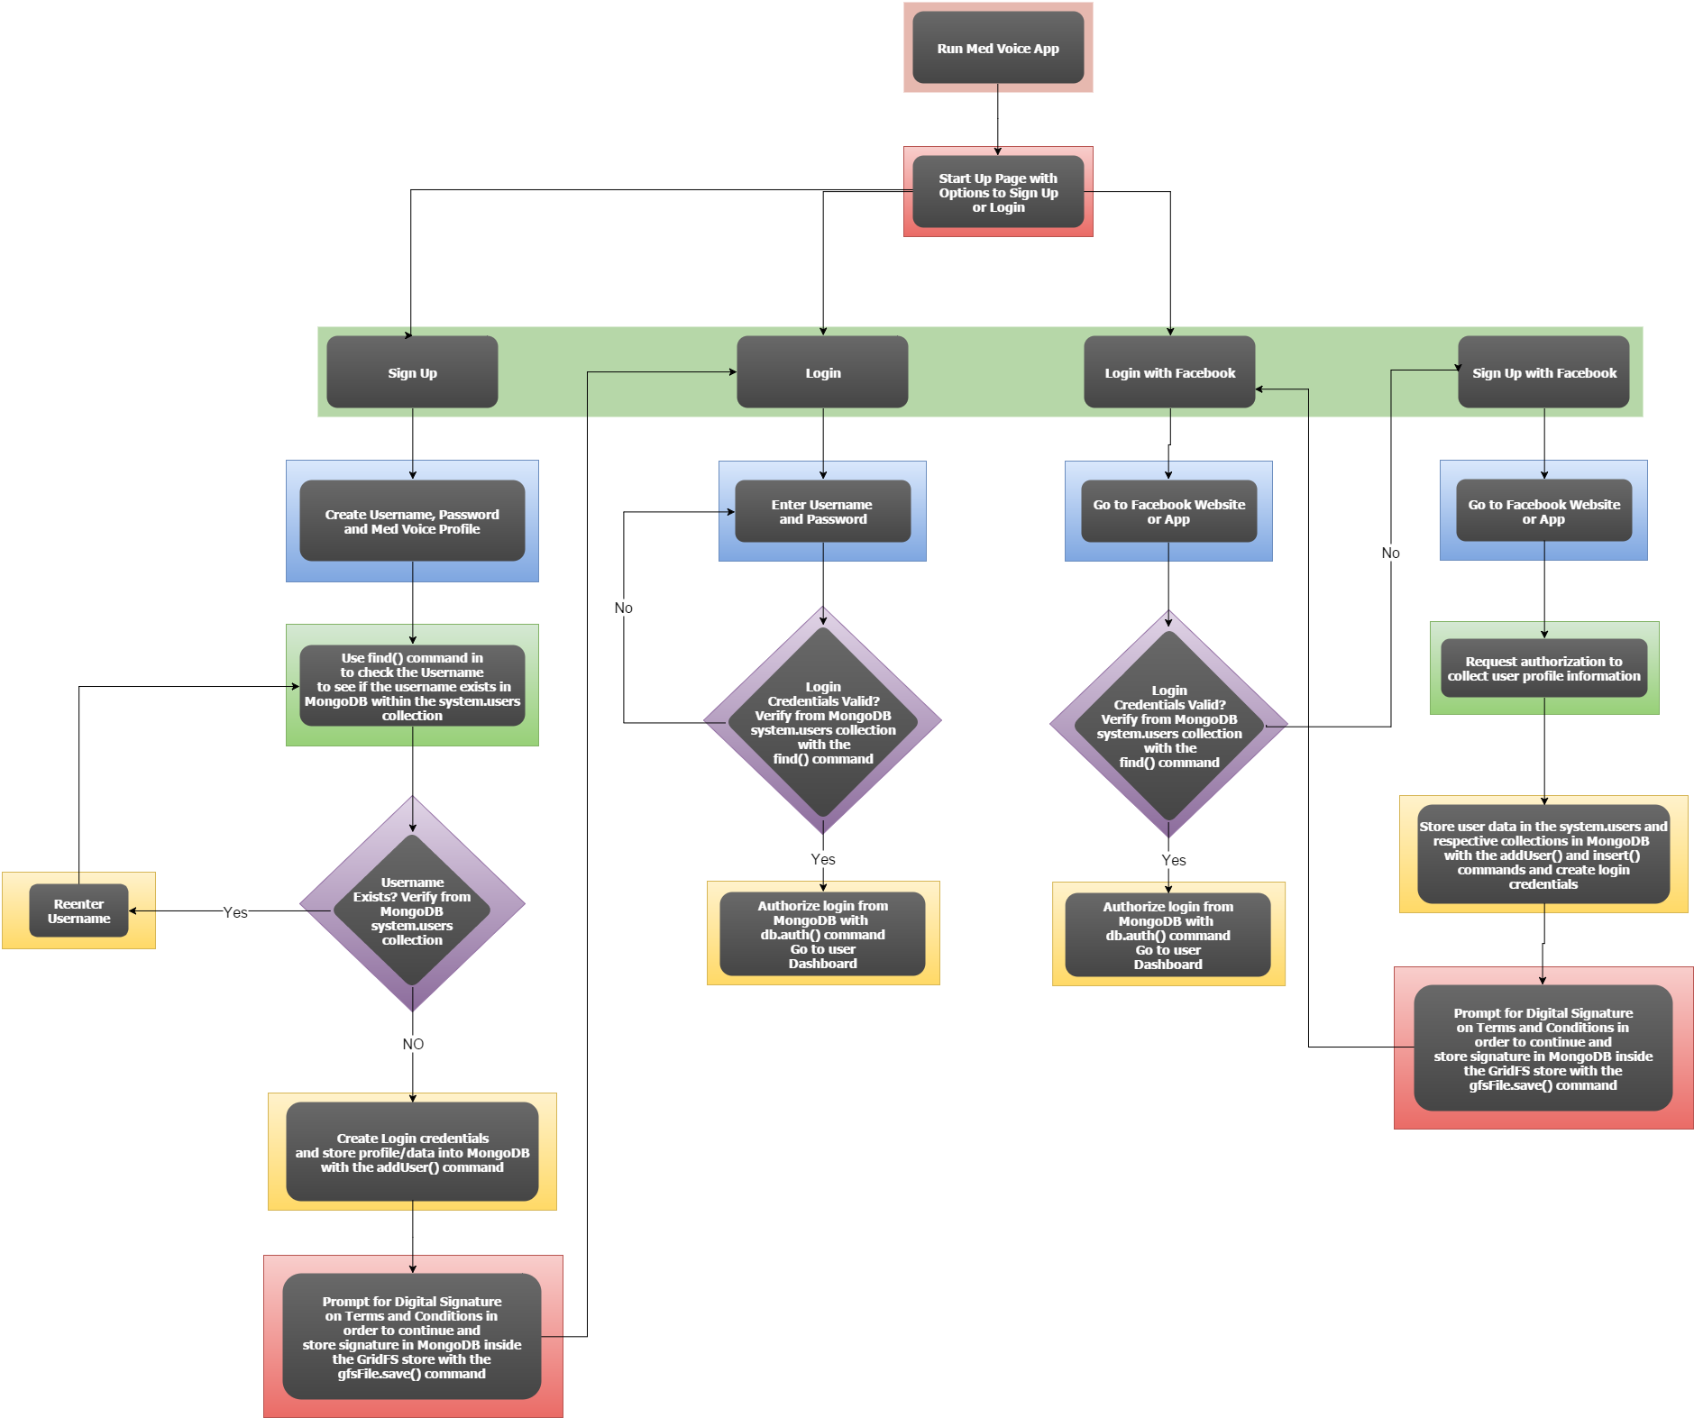
Sign up & Login flowchart
The main start up page will include options to Login and Sign Up. The Sign Up option will provide two separate means for a user to register for a MedVoice account. One sign up option will prompt the user to enter a username, email address, and a password while the other option would be a Facebook registration feature that would request authorization to collect some information from the user’s Facebook profile and then create login credentials. The Login option will also provide two separate means for a user to login to MedVoice and that would be with a regular sign in, as provided in the sign up process, or a Facebook login as long as the Facebook sign up has been performed prior to it.

Slide 5
Trade Study
Criteria | Weighted Scale | Sign Up with Full Profile |  | Sign Up with Username and Password
Sign Up Time | 25% | 7 | 1.75 | 10 | 2.5
Profile Completion | 25% | 9 | 2.25 | 1 | 0.25
User Experience | 50% | 7 | 3.5 | 10 | 5
TOTALS | 100% | 23 | 7.5 | 22 | 7.75
User Experience – Ultimate Goal
To optimize for a quick and easy registration process, health-related questions and a full MedVoice profile will be left out of the sign up activity. Users will be able to fill that out later on.
One issue that I haven’t taken into consideration is the different types of users that we want to have: Caregivers, Careclients, and Admins. The sign up experience for different types of users would have some differences in the types of questions asked, but that would be left out of the design for now.

Slide 6
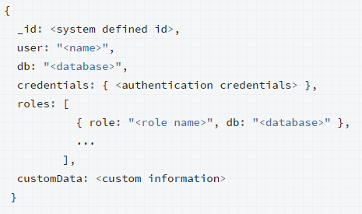
Data collections
system.users – Built-in collection of data in MongoDB for basic user information
GPS – Collection of data that will store user location
Signatures – Collection of data that is saved as binary that represents the images for digital signatures collected from the Terms & Conditions
Health – Collection of data that will store health related information
system.users Schema

Slide 7
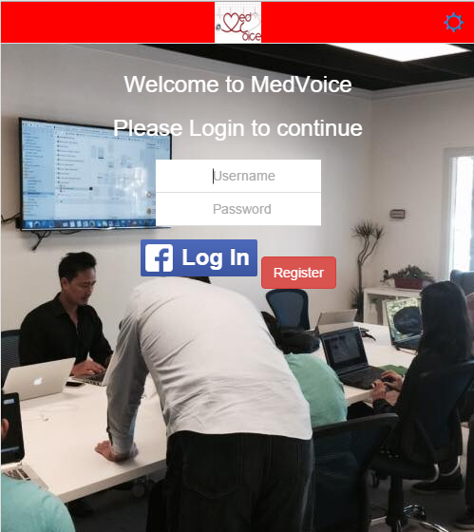
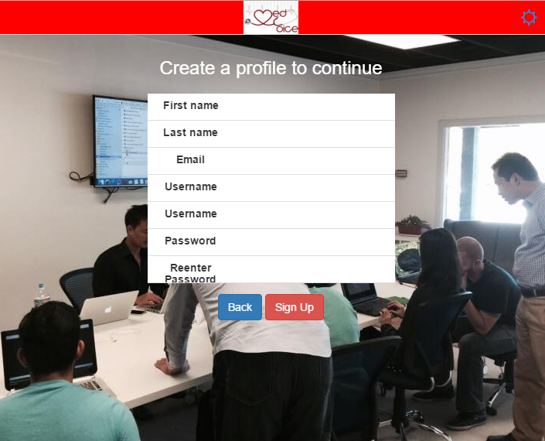
Start up screen and registration

